Slide 1

Hydrogen Sulfide Gas
OSHA 1910.1000
ANSI Z390.1-2006
RRC Rule 36
Copyright 2006

Slide 2
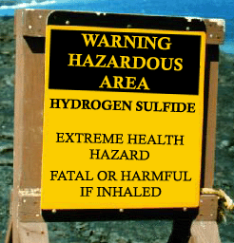
Training Goals for Year 2010 !!!!!!
Development of knowledgeable and competent employees who may be exposed to a sudden release of Hydrogen Sulfide gas.
Provide complete and consistent training to industry (Petroleum, Industrial, Municipal)

Slide 3
This class is in accordance with ANSI-Z390.1-2006 Accepted Practices for Hydrogen Sulfide (H2S) Safety Training Programs
I. Physical & Chemical Properties
II. Work Procedures
III. Methods of Detection & Monitoring
IV. SCBA (Hands On)
V. Human Physiology
VI. Respiratory Protection
VII. Final Exam for Certification

Slide 4

Why am I getting this information?
Hazardous Communication is required by Federal Law. 1910.1200
So you are properly prepared for release of hazardous chemicals. (H2S)
Copyright 2006

Slide 5
IT’S THE LAW !
In the State of Texas, all persons working in the oil field where H2S concentrations are known, MUST complete a H2S certification course annually.
The objective is to educate employees about the physical & chemical properties, toxicity, concentration levels, personal protective equipment use, detection measures, rescue and first aid.
The best way to reduce the chance of employee exposure to H2S is to provide the best possible training, provide appropriate personal protective equipment, and ensure employees follow correct work procedures, rules and requirements.

Slide 6

Who Counts On You?
WHO………COUNTS………ON……….YOU ?
Copyright 2009

Slide 7
Oh Yeah, by the way:
Hydrogen Sulfide Gas
is a toxic (poisonous) gas that
can kill you the first time you breath it!

Slide 8
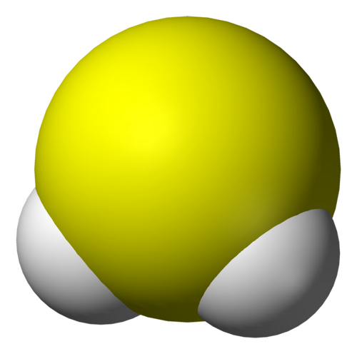
What is H2S?
H2S is naturally occurring chemical produced by
bacteria as it decomposes organic material.
It may develop in low oxygen
environments, such as, sewers,
swamps and polluted water.
S
H
H

Slide 9


It is a natural Product of
Decay or Putrefaction
You may find H2S in:
Dairies
Breweries
Chemical processes
Geothermal exploration
Fisheries
Tanneries
72 different Industries

Slide 10

Other Names for Hydrogen Sulfide
Sulfurated Hydrogen
H2S
Swamp Gas
Sour Gas
Rotten Egg Gas
Sewer Gas
Stink Damp
Meadow Gas
Hydrosulfuric acid
Dihydrogen sulfide

Slide 11

Physical Characteristics
Color – Clear/Transparent
Odor – Sweetish taste, unpleasant odor; described as rotten eggs.

Slide 12
Vapor Density
The weight of a gas as compared to air.
Air = 1
H2S = 1.189 @ 32 F
19% heavier than air

Slide 13

Hazardous Characteristics
Flammable
0%
100%
4.3%
BURN RANGE
LFL
46%
UFL
1% = 10,000 PPM
LEAN
RICH

Slide 14

If You take the chance … and Reject the Training, Safe work practices, and Safeguards that are in place.
Then Prepare, for the Fate that Follows !!

Slide 15

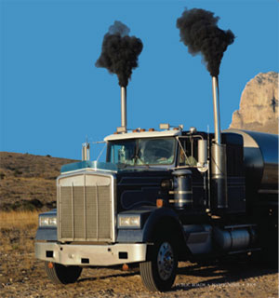
Auto Ignition Temperature
Hydrogen Sulfide will automatically
ignite at 500 ⁰F
End of lit cigarette – 1400 ⁰F
Diesel exhaust – 600-2400 ⁰F

Slide 16
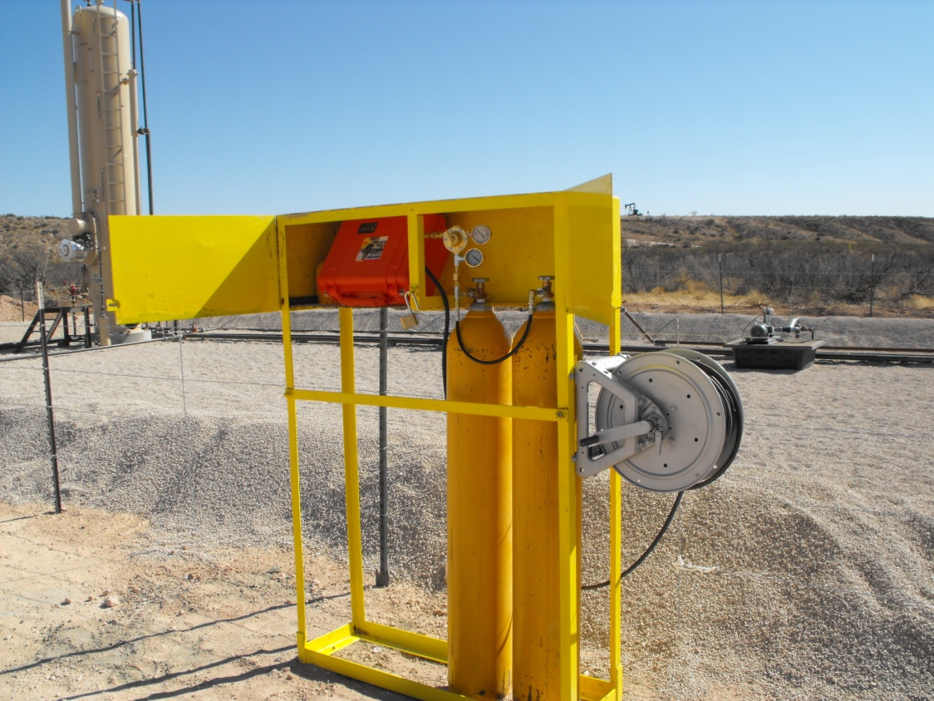
How do we control this toxic gas?
Engineering Controls
  Ventilation
    Natural
    Manufactured
  Flare Stack
  Venting
PPE
  Supplied Air Respirator
    SCBA
    Work line
    Escape Pack
Loco Hills, NM

Slide 17
What else can we do?
Tail gate meetings
Education
Buddy System
Be Wind Aware
Eliminate Ignition Sources
Keep non-essential personnel out of area
Checking Safety Equipment

Slide 18
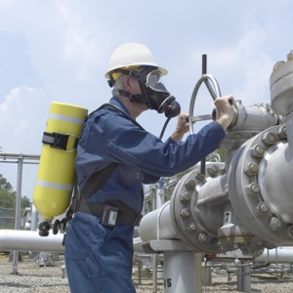
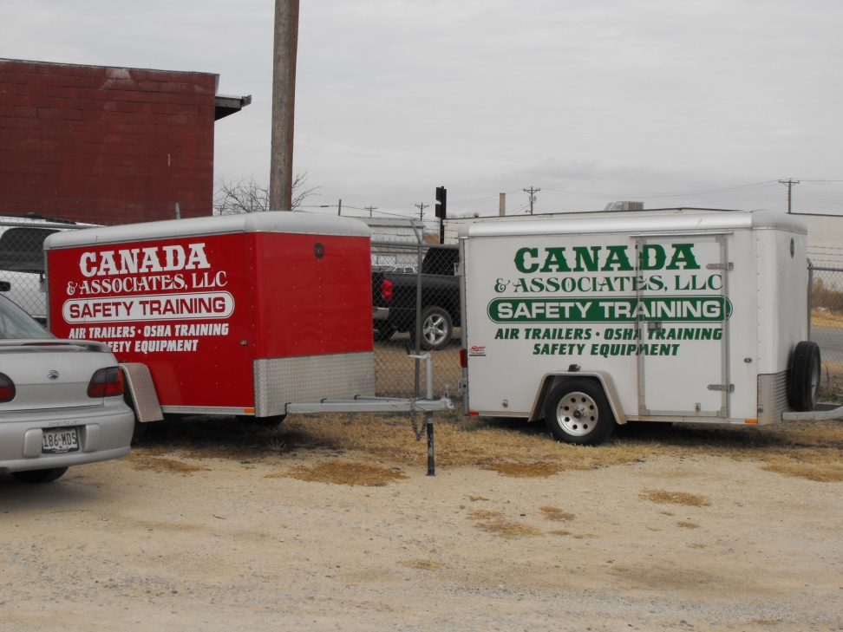
Supplied Air Sources
Self Contained Breathing Apparatus (SCBA)
Air Trailer – Work-line

Slide 19
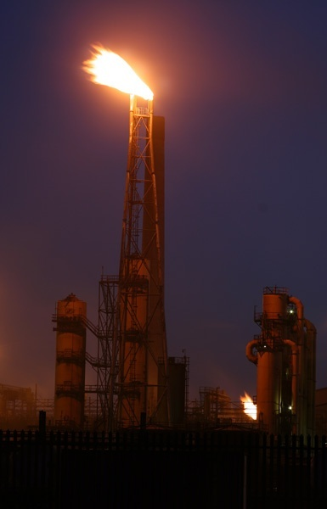
By-products of Burning
When H2S is burned, it produces
Sulfur Dioxide
Short-term exposures to high levels of sulfur dioxide can be life-threatening.
Exposure to 100 ppm of sulfur dioxide is considered immediately dangerous to life and health (IDLH)
PEL for SO2 is 2 ppm
Sulfur Dioxide may cause heart problems and respiratory disorders in younger children and elders.

Slide 20

Flare stack
If the flare stack is burning away 100,000ppm H2S and is burning at 80% efficiency, what is the ppm of H2S in the exhaust plume?
100,000ppm. The flare stack is burning 80% of the volume not the concentration.

Slide 21
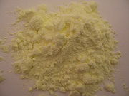
Iron Sulfide
H2S reacts with iron and steel which forms iron sulfide which can be Pyrophoric !
Iron sulfide treated with acids results in H2S being released.

Slide 22
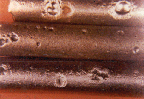
Hazardous Characteristics
Corrosive
H2S dissolves in water to form a weak acid that corrodes and pits metals.

Slide 23
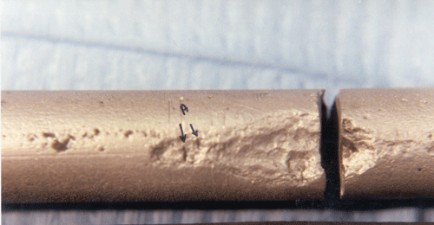
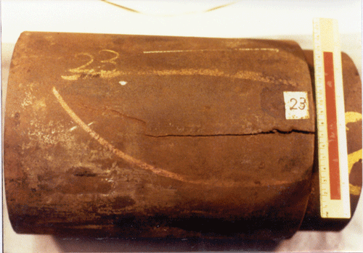
Metallurgy
H2S may react with iron and steel
causing hydrogen embrittlement
and/or sulfide stress cracking.
This lowers safety factors in tubular
and pressure vessels.

Slide 24

Hazardous Characteristics
Toxic
H2S is the second most toxic gas
known to man.
The most toxic is Hydrogen Cyanide
PEL of H2S = 10 ppm
PEL of HCN = 10 ppm

Slide 25


Target Organs
Eyes
Lungs
Nose
Respiratory
control center
Liver

Slide 26

Variables that determine the effects of H2S exposure
Time (how long)
Concentration (how much)
Frequency (how often)
Variables associated with the individual.

Slide 27


Individual Variables
Age
Physical
Condition
Drug/Alcohol
Compatibility
Body mass
Smoker/Non-Smoker

Slide 28


What is a Part Per Million (ppm)?
One part in a Million Parts.
1 / 1,000,000
0.0001
1 ounce in 31.25 tons
1 minute in 1.9 years
1 drop of Vodka in 80 fifths of 7-up.

Slide 29
Exposure Levels
PEL – 10 ppm / 8hr. TWA
PEL – 6.6 ppm / 12hr. TWA
PEL – 5 ppm / 16hr. TWA
STEL – 15 ppm / 15 min.
Ceiling Concentration – 50 ppm / once 10 min.
Human Lethal Concentration
100 - 800 ppm / 5min.
Revised IDLH – 100 ppm

Slide 30
ELECTRONIC
CHEMICAL REACTION
NOSE
The API-55 recommends that monitors be calibrated at least once a month.
They should be calibrated after each use with a Cal-Gas up to 50% of the
maximum scale of the instrument. A 10% variance is allowed.

Slide 31

Nose
Not Reliable
Olfactory Accommodation/Paralysis Occurs About 50-100 ppm.
A Good Method for Getting Killed!

Slide 32
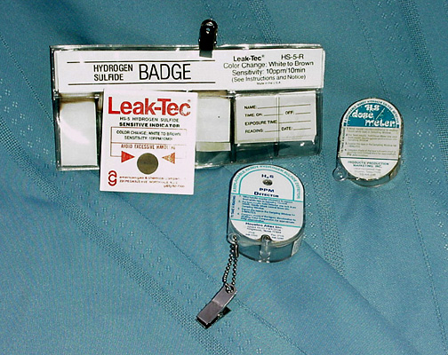

Slide 33
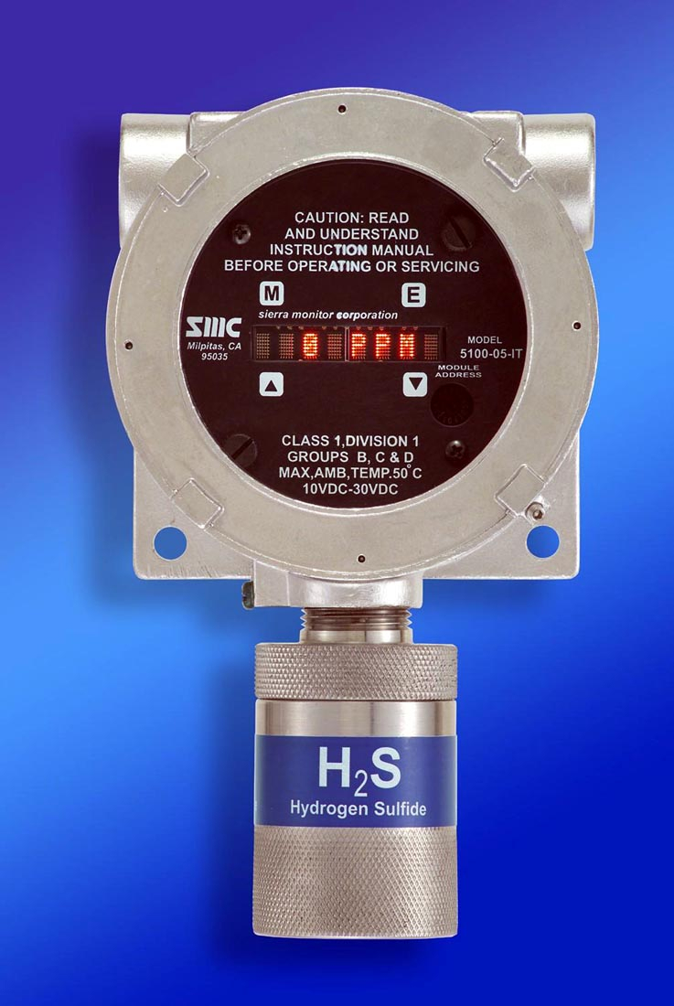
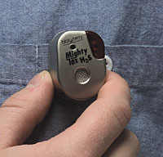

Fixed Monitor
Personal Monitors

Slide 34
Personal Monitor Limitations
The battery and sensor are sensitive
They work from a chemical reaction.
The reaction uses the chemical up.
When the chemical is used-up, the battery or sensor dies.

Slide 35

When the alarm sounds, leave the area
to a safe zone and not return until
the area is SAFE.

Slide 36

Contingency Plan
Evacuate in an upwind / uphill
direction. Report to briefing
area immediately.
Do not return to the area
until someone using proper
detection equipment has
re-evaluated the area and
approved it safe to re-enter.

Slide 37
H2S Signs
Do not be misled by signs reading
caution H2S or warning H2S.
H2S may be
present
H2S may be
present
Because of the characteristics of the gas. It has the ability to accumulate in levels above IDLH (100ppm).

Slide 38
H2S Signs
Poison
gas

Slide 39



Slide 40
Possible Danger - No Alarms.
All personnel on location must have a current one year H2S certificate from a formal H2S course.
Beards & sideburns must be trimmed as necessary to assure the seal
on the SCBA face piece will be free of hair.
Upon arrival at well site, report to supervisor to receive H2S briefing.
Familiarize yourself with the site’s Contingency Plan.
NO SMOKING except in specifically designated areas.
Inspect & practice putting on your specific breathing apparatus.
Know the location of the “Safe Briefing & Assembly Areas.”
Remain “Wind Conscious” at all times. Be prepared to move across
and “Upwind” in the event of an emergency involving an H2S release.

Slide 41
Moderate Danger - Intermittent Audible Alarm and Yellow Flashing Light. 10 - 50 ppm H2S
Go to “UPWIND” Safe Briefing Area if you are not specifically
designated to control the well.
Be alert for change in weather conditions.
Check your safety equipment for readiness.
During an emergency, use the ”BUDDY SYSTEM” to prevent anyone
from entering or being left alone in a contaminated area.
Report any indications of H2S to a supervisor.
Extinguish ALL SOURCES OF IGNITION after an alarm has been
activated.

Slide 42
Extreme Danger - Continuous Audible Alarm and
Red Flashing Light. > 50 ppm H2S
Same precautions as in Condition “Yellow.”
Don your SCBA.
Remain in Safe Briefing Area or Assembly Area and await
instructions for evacuation.
Provide assistance to anyone who may be injured by
toxic gases.
Personnel shall ensure that their breathing apparatus is
properly fitted and operational before entering an H2S
contaminated area.

Slide 43
Rescue
Rescue requires rescue training and practice drills. NEVER attempt a rescue you are not properly trained for.

Slide 44
Review
10 PPM
ANSI PEL =
ANSI STEL=
ANSI IDLH=
15 PPM
100 PPM

Slide 45
The wind is blowing 20 mph from the N. Which SBA would
you go to and how would you get there?
SBA
SBA

Slide 46

WHICH WAY TO GO?
WIND DIRECTION
SOURCE OF H2S
CONCENTRATION DECREASES AWAY FROM SOURCE
CONCENTRATION DECREASES FROM CENTER
GO CROSSWIND AND UPWIND!

Slide 47
IS 8 PPM H2S REALLY SAFE?
BYE, BYE AIR!
OUTFLOW LINE
HIGH PPM H2S
H2S
H2S
8 PPM OUTFLOW
HIGHH2S
H2S
H2S HEAVIER THAN AIR
AIR
H2S
HIGH PPM H2S
H2S
STORAGE TANK

